Slide 1
Introduction to Apache Hive
Jian Wang
11/28/2013

Slide 2
Background
Apache Hive is a data warehouse infrastructure built on top of Hadoop for providing data summarization, query, and analysis.^{[1]} While initially develoother ped by Facebook, Apache Hive is now used and developed by companies such as Netflix.
Built at Facebook
Tools to enable easy data extract/transform/load (ETL)
A mechanism to impose structure on a variety of data formats
Access to files stored either directly in Apache HDFS (TM) or in other data storage systems such as Apache HBase (TM)
Query execution via MapReduce

Slide 3
Components
Shell: allows interactive queries like MySQL shell connected to database
– Also supports web and JDBC clients
• Driver: session handles, fetch, execute
• Compiler: parse, plan, optimize
• Execution engine: DAG of stages (M/R, HDFS, or metadata)
• Metastore: schema, location in HDFS, SerDe

Slide 4
Hive Applications
Log processing
• Text mining
Hive Applications
• Document indexing
• Customer-facing business intelligence (e.g., Google Analytics)
• Predictive modeling, hypothesis testing

Slide 5
Data Model
Tables
Data Model
– Typed columns (int, float, string, date, boolean)
– Also list: map (for JSON-like data)
• Partitions – e.g., to range-partition tables by date
• Buckets
– Hash partitions within ranges (useful for sampling, join optimization)

Slide 6
Physical Layout
• Warehouse directory in HDFS
– e.g., /home/hive/warehouse • Tables stored in subdirectories of warehouse
– Partitions, buckets form subdirectories of tables
• Actual data stored in flat files – Control char-delimited text, or SequenceFiles – With custom SerDe, can use arbitrary format

Slide 7
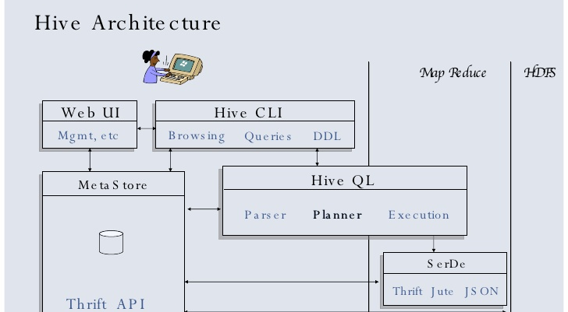
Hive Architecture

Slide 8
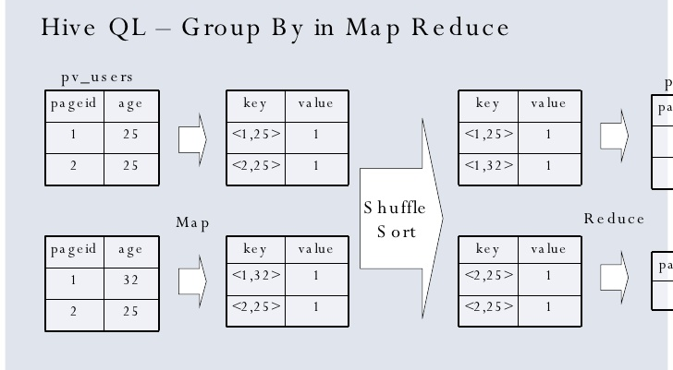

Slide 9
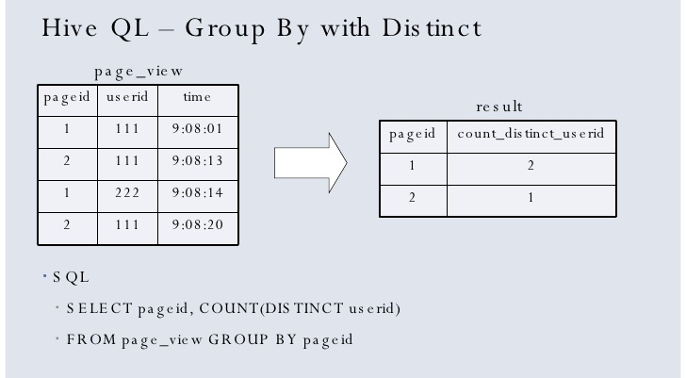

Slide 10
Play with Hive !
Datasets (CSV format)
Each line:
Books are identified by their respective ‘ISBN’;
`Book-Title`; `Book-Author`; `Year-Of-Publication`; `Publisher`; ‘Image-URL-S`; `Image-URL-M`; `Image-URL-L’
Clean the format, make sure contents of each attribute can be identified by ‘;’

Slide 11
Procedures
Download hive-0.12.0.tar.gz from apache mirror
Extract the tar file and set up hadoop environment
Run command:
-start-all.sh
Copy the dataset from local to hadoop hdfs location

Slide 12
Run hive and create table for datasets
$hive
hive> CREATE TABLE IF NOT EXISTS BXDataSet
> (ISBN STRING,
> BookTitle STRING,
> BookAuthor STRING,
> YearOfPublication STRING,
> Publisher STRING,
> ImageURLS STRING,
> ImageURLM STRING,
> ImageURLL STRING)
> COMMENT 'BX-Books Table'
> ROW FORMAT DELIMITED
> FIELDS TERMINATED BY ’\;'
> STORED AS TEXTFILE;
hive> LOAD DATA INPATH ’file location' OVERWRITE INTO TABLE BXDataSet;

Slide 13

Count how many books were published each year
hive> select yearofpublication, count(booktitle) from bxdataset group by yearofpublication;

Slide 14
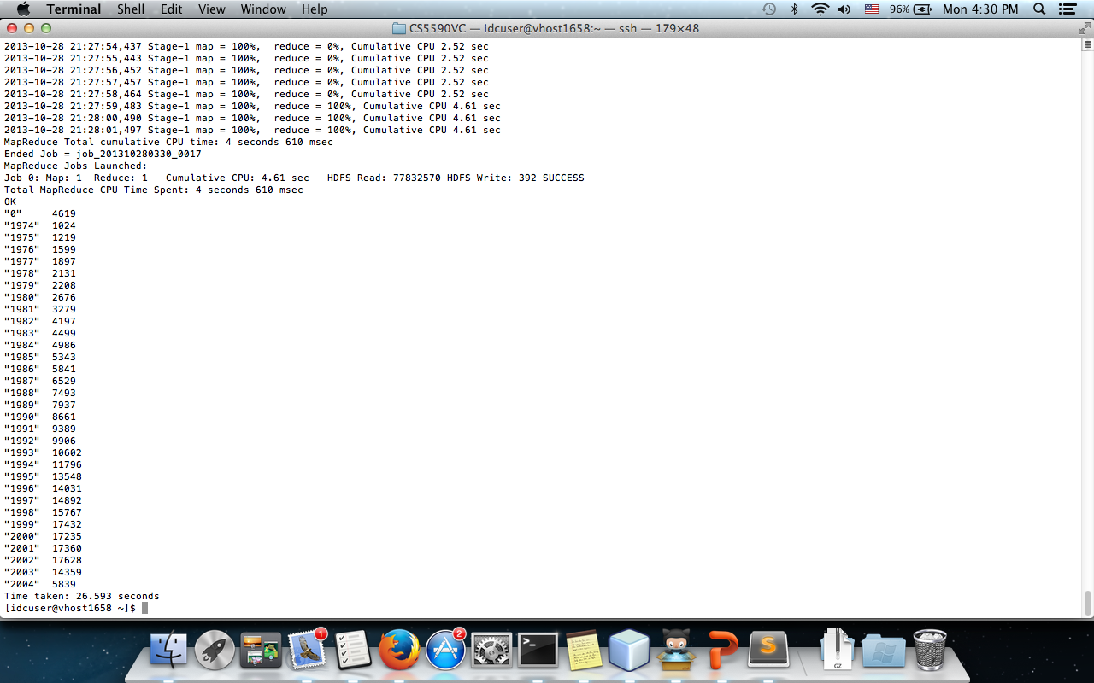
Only show years when total books # published are bigger than 1000
select * from(
select yearofpublication, count(booktitle) row_number from bxdataset group by yearofpublication) A
where row_number > 1000;

Slide 15
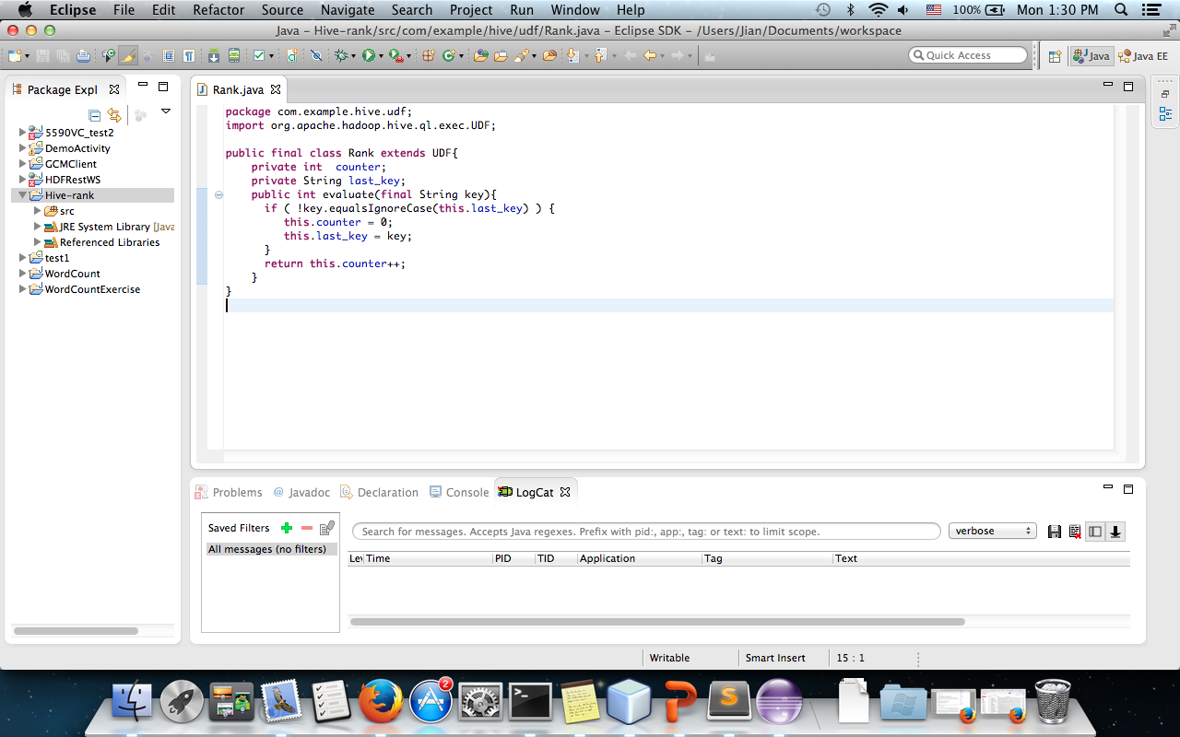
User-defined functions

Slide 16
Test3.sql
add jar /home/idcuser/rank.jar;
create temporary function rank as 'com.example.hive.udf.Rank';
select yearofpublication, booktitle, row_number from (
select yearofpublication, booktitle, rank(booktitle) as row_number from(
select * from bxdataset where yearofpublication is not null
distribute by booktitle
sort by booktitle, yearofpublication
) A
)B
where row_number >5;
Run hive –f test3.sql

Slide 17
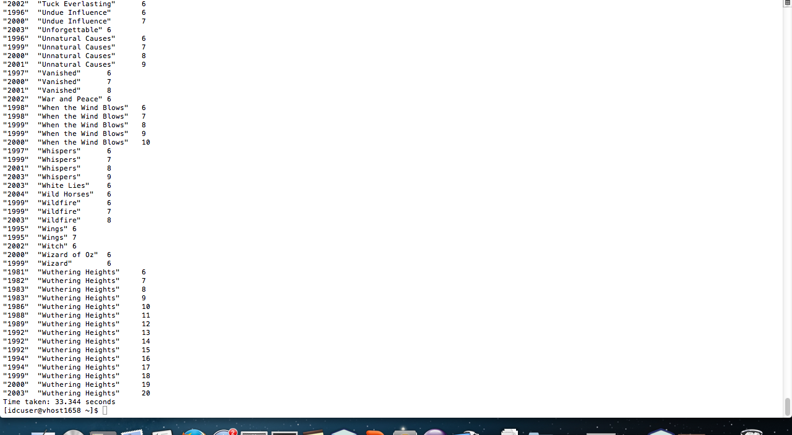
Screenshot of output

Slide 18
Conclusion
Supports rapid iteration of ad-hoc queries
• Can perform complex joins with minimal code
• Scales to handle much more data than many similar systems

